Slide 1
Security Engineering CSE 352/CSE 552 Instructor: Sambuddho Chakravarty
Sambuddho Chakravarty
(Semester: Winter 2016)
Final Review: April 18

Slide 2
Diffie Hellman Key Exchange: Key exchange Without an Online TTP.
Goal: Alice and Bob want shared secret, unknown to eavesdropper
For now: security against eavesdropping only (no tampering)
Alice
Bob
eavesdropper

Slide 3
The Diffie-Hellman protocol (informally)
Fix a large prime p (e.g. 600 digits)
Fix an integer g in {1, …, p}
Alice
Bob
choose random a in {1,…,p-1}
choose random b in {1,…,p-1}
“Alice”: A ← gª (mod p)
“Bob”: B ← g^{b} (mod p)
Bª (mod p) = (g^{b})ª =
k_{AB} = g^{ab} (mod p)
= (gª)^{b} = A^{b} (mod p)
Notes:
“Alice”, A = ga (mod p) ; “Bob”, B = gb (mod p)

Slide 4
Man-in-the-Middle (MITM) Attack
As described, the protocol is insecure against active attacks
Alice
MiTM
Bob
A ← gª (mod p)
A’ ← g^{a’} (mod p)
B’ ← g^{b’} (mod p)
B ← g^{b} (mod p)
g^{ab’} (mod p), g^{a’b} (mod p)

Slide 5
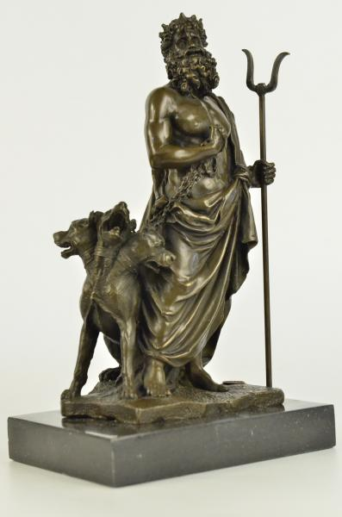
Kerberos
Brief background:
Developed in MIT for Project Athena to protect network services.
Uses symmetric keys.
V1-4 directed towards Project Athena.
V5 appeared as RFC 1510 – Was classified as aux. military technology
and banned its export because it involved using DES.
Non-US V4 designed by Royal Inst. of Technology in Sweden.
Latest version: 2005 (designed by the IETF Kerberos Working Group)
Objective:
Used to authenticate users and allow nodes to communicate with one another over a non-secure medium. Confidentiality and forward secrecy assured.
Implementations
Used in Microsoft Active Directory server in Win 2k server, 2003 R2, 2008, 2008 R2 and 2012 R2

Slide 6
Basics of Kerberos Protocol
Objective:
Designed for client-sever environment wherein a user might want to use a service over an insecure medium (e.g. LAN).
Use cases: Print server, remote login shell, DNS, domain authentication etc.
Network entities
Server – resource that could be accessed by the client and TGS
Client – wants to access the resource.
Ticket – a temporal access privilege assurance to the resource.
Ticket Granting Server – the server that issues the ticket.
KDC – key distribution server – knows about the private keys of all entities.

Slide 7


The Actual Protocol
Authentication
Server
KDC
Client → AS: user ID (1)
Client
Enc. Key K_{C} ← H(password)
E(K_{C,TGS})_{Kc}
E(TGT) _{KTGS}
TGS
E(TGT) _{KTGS} || E(Authenticator) _{C,TGS}
E(Client-to-server ticket) _{KS}
E(K_{C,S}) _{Kc,TGS}
Server
E(Client-to-server ticket) _{Ks} || E(Authenticator) _{Kc,S}
E(TS in Authenticator + 1) _{Kc,S}

Slide 8
Key Drawbacks of Kerberos
Availability of KDC + centralized point of failures and vulnerabilities.
Time synchronization and strict deadlines.
No standardized implementations.
Scalability : Every user and server needs it own private keys.

